Slide 1
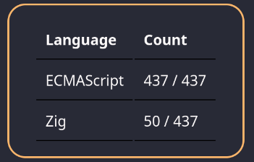
ECMAScript Process Documents
Kai Waløen 15/05/2025

Slide 2
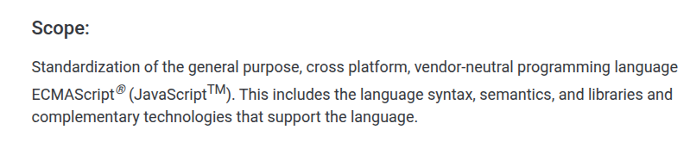
ECMAScript vs JavaScript?
ECMAScript == JavaScript
  “JavaScript” is trademarked by Oracle
  “ECMAScript” is a registered trademark by Ecma International

Slide 3
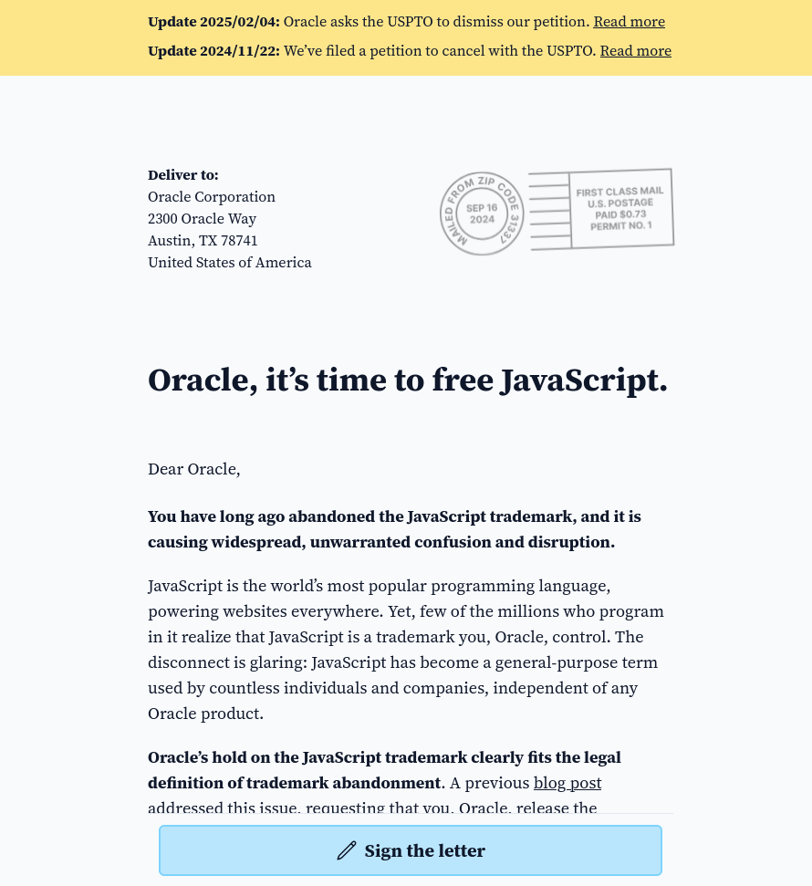
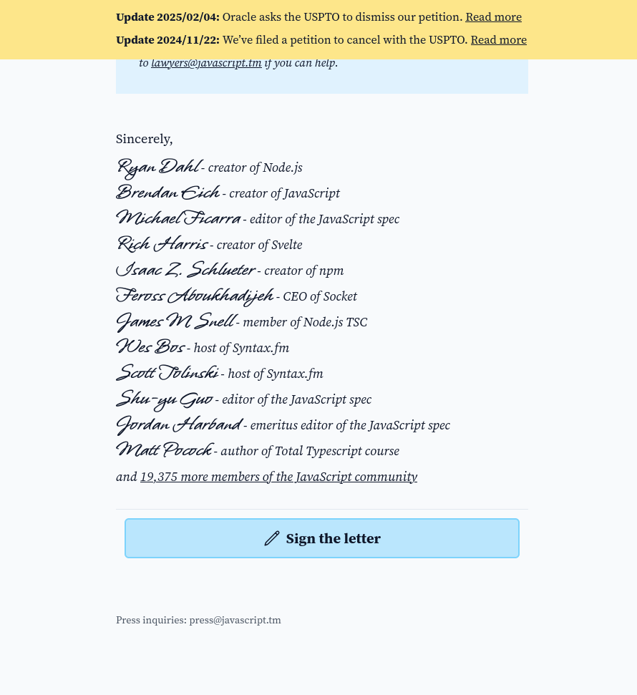
19388 Signatures
https://javascript.tm/sign

Slide 4
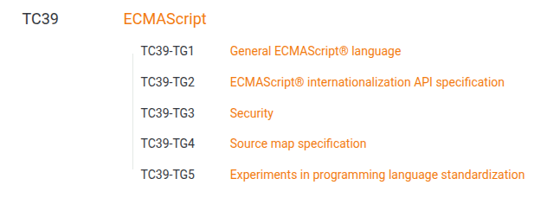
Ecma International
Ecma International
  Standardization Organization
  Standards: ECMA-1 → ECMA-499
    Notable mentions
      ECMA-334: C# Programming Language
      ECMA-404: JSON
      ECMA-408: Dart Programming Language
ECMAScript Specifications:
    ECMA-262: ECMAScript Language Specification
    ECMA-402: ECMAScript Internationalization API Specification
Technical Committee and Task Groups
  TC39 works on ECMAScript
https://en.wikipedia.org/wiki/List_of_Ecma_standards

Slide 5
TC39 Process
Overview:
  Ecma Technical Committee 39 (TC39) is responsible for evolving the ECMAScript programming language and authoring the specification.
  The committee operates by consensus.
  Operate by 6 Stages
    Stage 0
    Stage 1
    Stage 2
    Stage 2.7
    Stage 3
    Stage 4
  The committee must approve proposal to progress to next stage
https://tc39.es/process-document/

Slide 6
Roles
Champion
  Author of proposals
  Responsible for evolution of the proposal
  Presenting the proposal to the committee
Reviewer
  Assigned to a proposal
  Give feedback to the Champions
  Anyone can be a reviewer but cannot be a Champion of the proposal in question
Editors
  Responsible for structure and coherence of the specification and spec-texts
  Provide guidance and feedback to spec text authors to assist in proposal maturation
  May or may not be a Champion
Committee delegate
  Vote on approval of a proposal
  Can give feedback on proposals
  Can give conditional approval and work with the Champion to work towards approval

Slide 7
Stages Table
Well defined stages with good descriptions
  However missing some details mentioned elsewhere in process documents
Entrance criteria per stage
Purpose of each stage

Slide 8
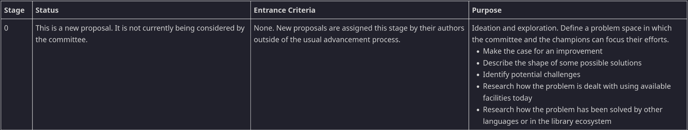
Stage 0
Anyone can submit a proposal
  Non-delegates must register

Slide 9
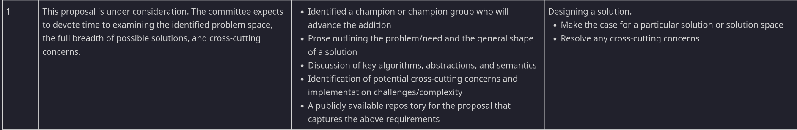
Stage 1
TC39 owned Github repositories from Stage 1
Planning and designing a solution
https://github.com/tc39/proposals

Slide 10
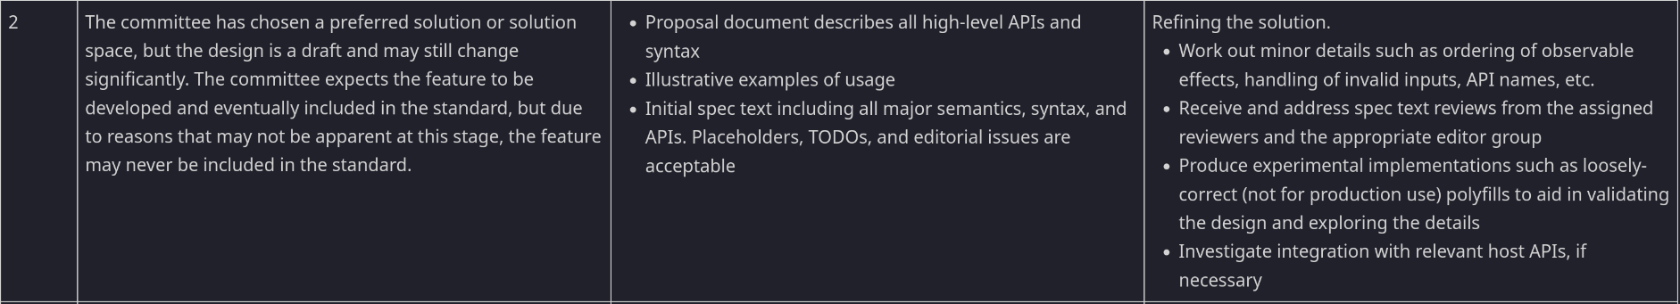
Stage 2
Solution has been chosen and refining solution
Inital spec text
Committee designates reviewer – not by champion
“When reviewers are designated, a target meeting for Stage 2.7 should be identified.”
Sign off by reviewer means Stage 2.7

Slide 11
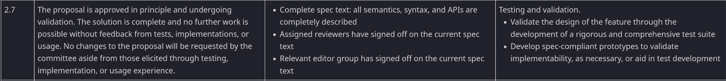
Stage 2.7
Proposal is approved and solution is complete
Testing stage and completion of spec text
Test262 authored and submitted

Slide 12
Stage 3
“Solution is complete”
Integration and implementation stage

Slide 13
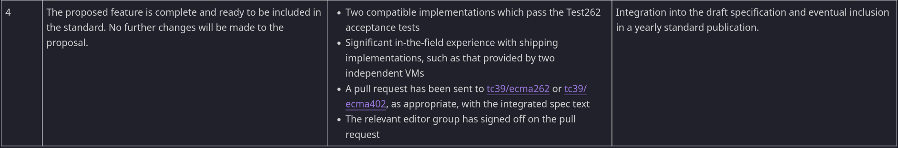
Stage 4
Shipped 🚀

Slide 14
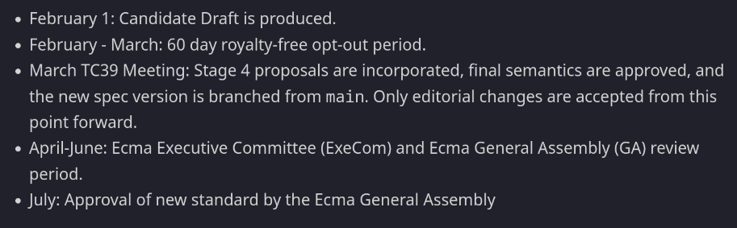
Yearly approval of new standard

Slide 15
My Impressions
Well documented
Promotes cooperation and efficiency
Promotes flexibility

Slide 16
Promotes cooperation and efficiency
Tips for achieving conensus
  “Feedback and concerns should be raised early and asynchronously to help the champion resolve any issues efficiently.”
Document reason for not advancing
  “This helps us understand issues in the proposal and similar proposals in a cohesive way.”
Conditional advance
  Urges delegate and champions to work together to solve issues
  “The delegate should give the champion an actionable request for how to facilitate the analysis”
  “Conditional advancement is time-limited, giving the person raising the concern time to discuss with the champions and authors about their concerns.”
  “If the issue is resolved, the proposal automatically reaches the next stage without further discussion by the committee. If the issue cannot be resolved, the proposal does not advance. “

Slide 17
Promotes Flexibility
No concept of rejection
  “When possible, it is preferable to raise an actionable constraint. The committee does not have an established concept of a rejected proposal--it is always possible for the champion to make changes and come back to ask for consensus. “
  But this means potential for many inactive proposals
Champions can adopt proposals
A champion can demote or withdraw their proposals
  But must give a reason
“The committee may elide the process based on the scope of a change under consideration, as it sees fit.”

